Slide 1

Automate the Tower LifeCycle through Digitization
By Pallavi Mulik

Slide 2
Overview
It automates the engineering workflows
It provides the load new equipment, analyze mount data and more
Most engineering analysis necessary for tower maintenance and equipment updates

Slide 3
Technologies Used
Database – Azure SQL Server Database
Application Tools – Visual Studio 2019(DB), Visual Studio 2022(API)
Database Tools – SQL Server Management Studio v19
Language – C#
Framework - .NET 3.1
Data Format – JSON, XML

Slide 4
Details of Training Activities
Define DB Schema to save and retrieve elevation-operators
1
Add Master data in 'Operator’ Table
2
Write SP to retrieve Operators information
3
Write SP to Retrieve Specific Operator Information
4

Slide 5
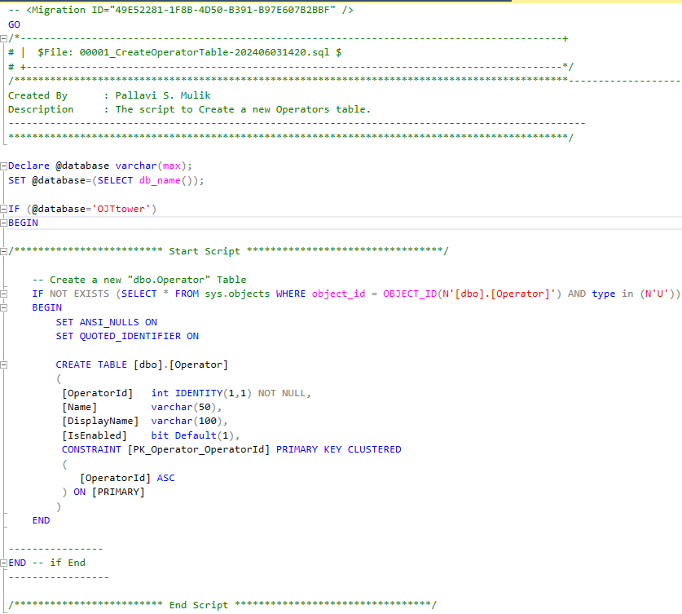
Define DB Schema to save and retrieve elevation-operators

Slide 6
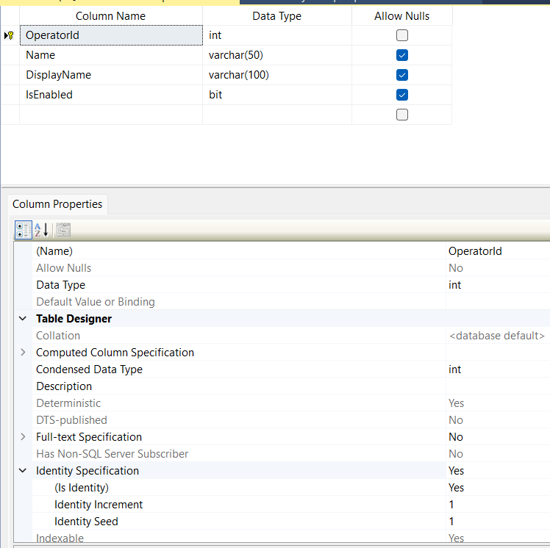
Table Schema - Output

Slide 7
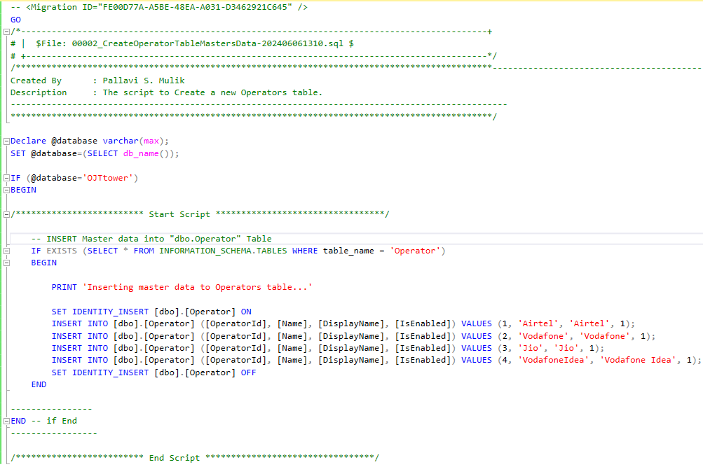
Add Master data in 'Operator’ Table

Slide 8
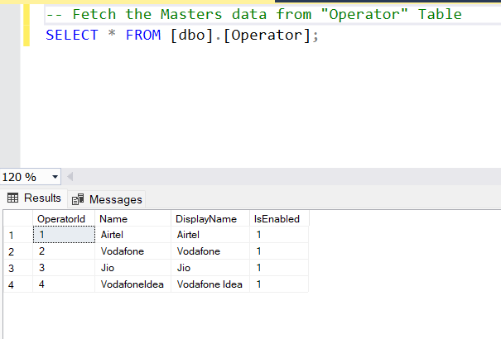
Master data – “Operator” Table

Slide 9
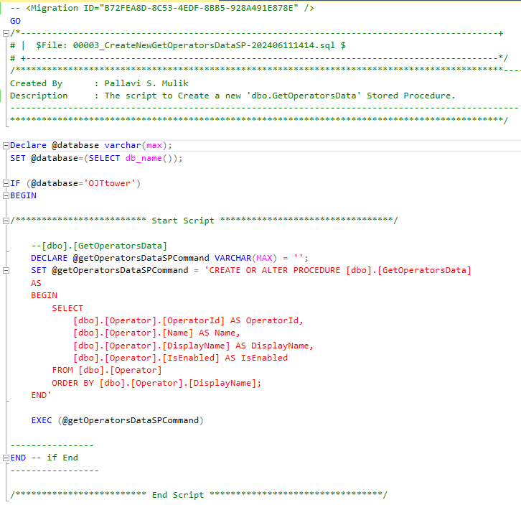
Write SP to retrieve Operators information

Slide 10
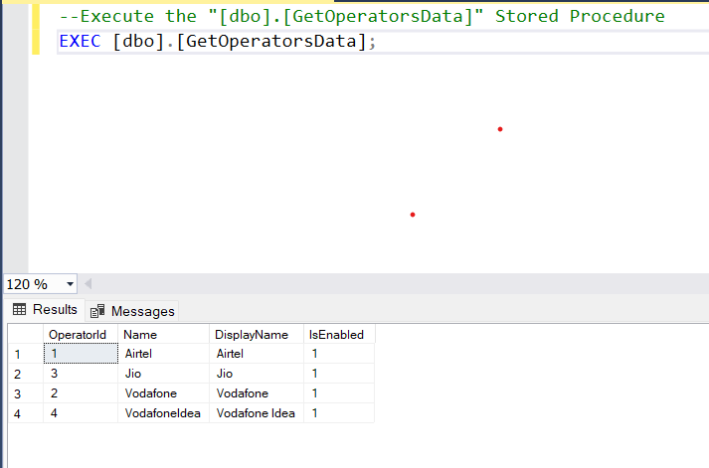
“GetOperatorsData” Stored Procedure - Output

Slide 11
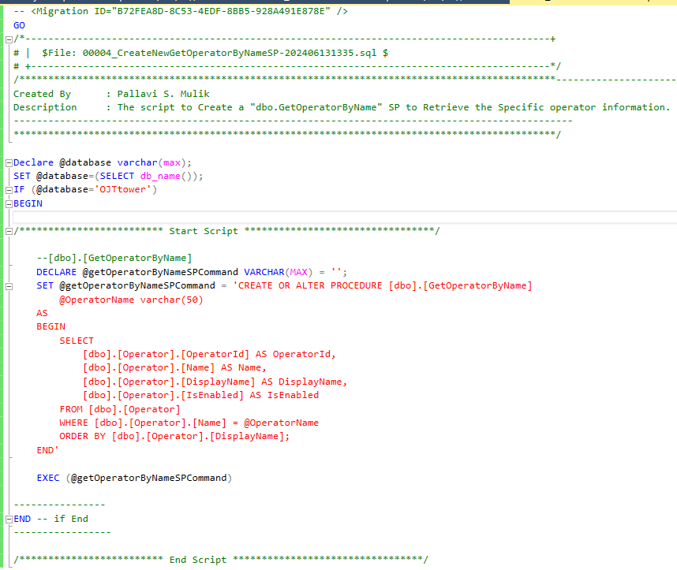
Retrieve Specific “Operator” information SP

Slide 12
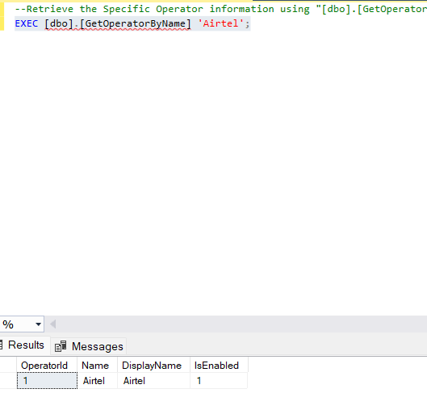
Retrieve Specific Operator - Output

Slide 13
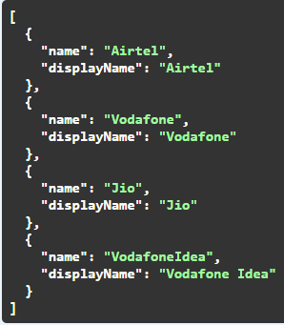
API to Retrieve the all “Operators” information - Output

Slide 14
Thank you

